Slide 1
FILE PACKER AND UNPACKER
Guided by : Mahajan Sir
Group Name : Sigma
Date of presentation:
13/01/2023
Presented By :
- Harshal Patil
- Vaishnavi Hagawane
- Payal Gaikwad
-Yugal Wani

Slide 2
Abstract
This project introduces a versatile File Packer and Unpacker designed to enhance data organization, compression, and transfer efficiency. The system provides a user-friendly interface for packing multiple files into a single compressed archive, streamlining storage and facilitating seamless transfer. Conversely, the unpacking feature enables the extraction of files from compressed archives, restoring the original structure with ease.
Key features include an intuitive graphical user interface, allowing users to select files or directories for packing and specifying compression parameters. The Unpacker function ensures quick and reliable extraction of files from compressed archives, preserving the hierarchical organization and original file attributes.
This project addresses the growing need for efficient file management, especially in scenarios involving the transfer of large datasets or the conservation of storage resources. The File Packer and Unpacker provide a reliable solution, enhancing the overall file-handling experience for users across different environments. The modular architecture of the system allows for future enhancements and compatibility with emerging compression standards.

Slide 3
Table of Content
Introduction
Methodology
Result
Future Scope
Conclusion
References

Slide 4
Introduction
The File Packer Unpacker project is a file compression and decompression utility implemented in Java. It offers a user-friendly interface for efficiently packing multiple files into a single compressed file and subsequently unpacking them as needed. This project provides a practical solution for optimizing storage space, streamlining data transfer, and enhancing file management. The primary objective of this project is to facilitate process monitoring. This involves the systematic observation and collection of data related to various processes or activities.
A key functionality of the project is its ability to fetch data from multiple files. This implies that the system can access and retrieve information from various sources simultaneously. This feature is particularly beneficial in scenarios where data is distributed across multiple files, and there's a need to consolidate or analyze information collectively.
The project offers a solution to merge the data obtained from multiple files into a single, consolidated file . In addition to data consolidation, the project allows for the creation of packed files. Packed files serve as compressed archives containing multiple files. The ability to extract data from packed files when required enhances flexibility. Users can unpack and access the original files, enabling efficient data retrieval and utilization.

Slide 5
Methodology
Packing Activity:
In case of packing activity we accept directory name and file name from user.
We have to create new regular file as the name specified by the user.
Now open the directory and traverse each file from that directory. In newly created file write Metadata as header and actual data in sequence.
While writing data perform encryption.
Each name of file , its size and checksum should be written in log file which gets created in system directory.
After packing display packing report.

Slide 6
Methodology
Unpacking Activity:
In case of Unpacking activity we accept packed file name from user. For authentication of packed file use any logic like Magic Number.
Open the packed file in read mode and perform below activity as Read header
From the name specified in header create new file.
Write data into newly created file from packed file.
Repeat all above steps till we reached at end of the file unpacked file.
After unpacking display unpacking report.

Slide 7
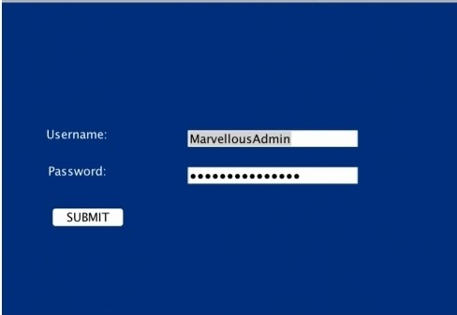
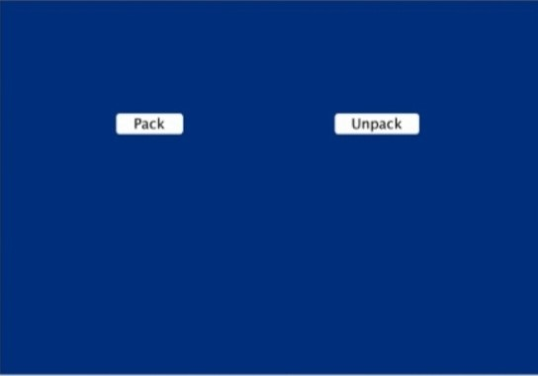
Result

Slide 8



Slide 9
Future Scope
Enhanced Compression Algorithms : Explore and implement more advanced compression algorithms to further optimize file sizes without compromising data integrity. Keeping abreast of developments in this field can lead to improved performance and efficiency.
Cloud Integration : Incorporate features that facilitate the direct packing and unpacking of files from cloud storage services. This can include integration with popular cloud platforms such as Google Drive, Dropbox, or Microsoft OneDrive.
Security Features: Integrate advanced encryption and password protection features to enhance the security of packed files. This is especially important for sensitive data and confidential information.

Slide 10
Future Scope
User Interface Enhancements : Continuously refine the user interface for better usability and accessibility. Consider incorporating modern design principles and customization options to cater to a diverse user base.
Intelligent File Sorting : Develop algorithms that intelligently analyze and categorize files before packing, allowing for more efficient organization and retrieval of data within the packed archive.
Performance Optimization : Focus on optimizing the performance of the File Packer and Unpacker, ensuring quick and resource-efficient operations, even with large or complex datasets.
Collaborative Features : Enable collaborative packing and unpacking, allowing multiple users to work on the same set of files simultaneously. This can be particularly valuable for team projects and collaborative environments.
File Format Support : Stay updated with emerging file formats and standards, ensuring ongoing compatibility with the latest technologies and industry requirements.

Slide 11
Conclusion
This project is used to perform packing and unpacking activity for multiple types of files.
In case of Packing activity me maintain one file which contains metadata and data of multiple files from specified directory.
In case of Unpacking activity we extract all data from packed files and according to its metadata we create all files.
In this project we have to use awt and swing as Front end and java as a Backend.

Slide 12
References
Bruce Eckel, "Thinking in Java", 4th ed, 2007
Core Java 2, Volume I--Fundamentals (Core Series) by Cay S. Horstmann | Goodreads.
The online Java tutorial @ https://docs.oracle.com/javase/tutorial/.

Slide 13
THANK YOU!!!

